Slide 1
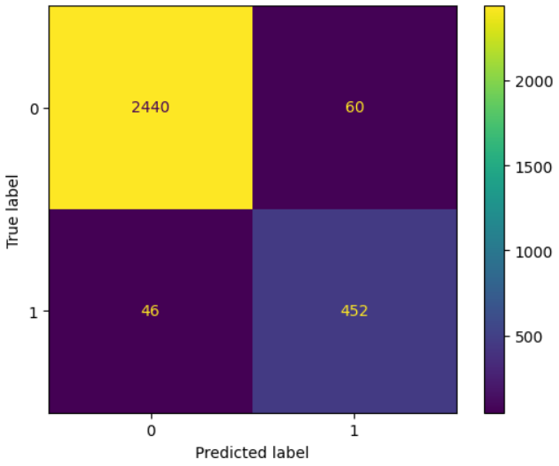
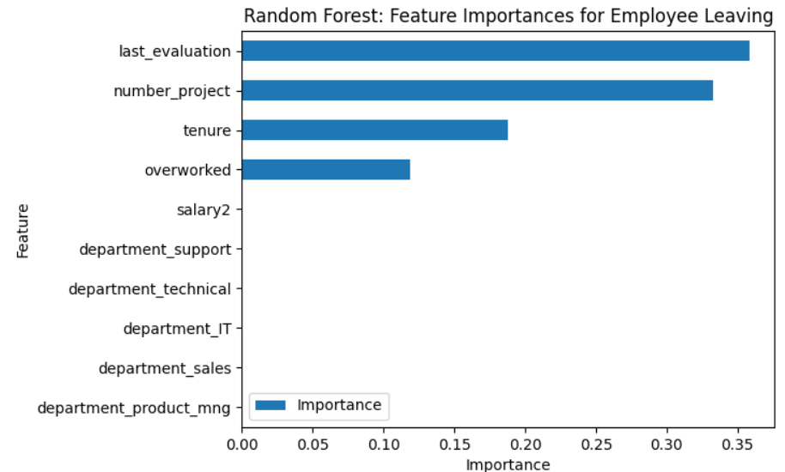
Project Overview
Currently, there is high turnover among Salifort Motors’ (‘SM’) employees. High turnover rate is costly as SM invests in recruiting, training, and upskilling its employees. If SM could predict whether an employee will leave the company, and discover the reasons behind their departure, they could better understand the problem and develop a solution.
Machine Learning
Model Results
EDA showed many SM employees are overworked, with avg. monthly hours above 200. We succeeded in building a machine learning model that predicts accurately 92% of the employees that will leave
To reduce employee turnover, the following actions would help:
* Cap the number of projects that employees can work on
* Consider promoting employees who have been with the company for at least four years, or conduct further investigation about why four-year tenured employees are dissatisfied.
* Reward employees for working longer hours, or don't require them to do so.
* If employees aren't familiar with the company's overtime pay policies, inform them about this. If the expectations around workload and time off aren't explicit, make them clear.
* Hold company-wide and within-team discussions to understand and address the company work culture, across the board and in specific contexts.
* High evaluation scores should not be reserved for employees who work 200+ hours per month. Consider a proportionate scale for rewarding employees who contribute more/put in more effort.
Since it’s prediction capabilities are excellent, deploy the model that doesn’t use satisfaction data and monthly avg. working hours. The data required for this model is more realistic to collect for future employee turn-over predictions.
Consider building a model that doesn’t require last evaluation data, specially if evaluations are not performed frequently

